Slide 1
Azure Data Factory Getting Data into Azure
Amy Nicholson – Technical Evangelist
@AmyKateNicho
Notes:
Introduction
Today I want to talk to you about transforming data into intelligent action, some stories of those who have done this and some technologies that can help you do it.

Slide 2
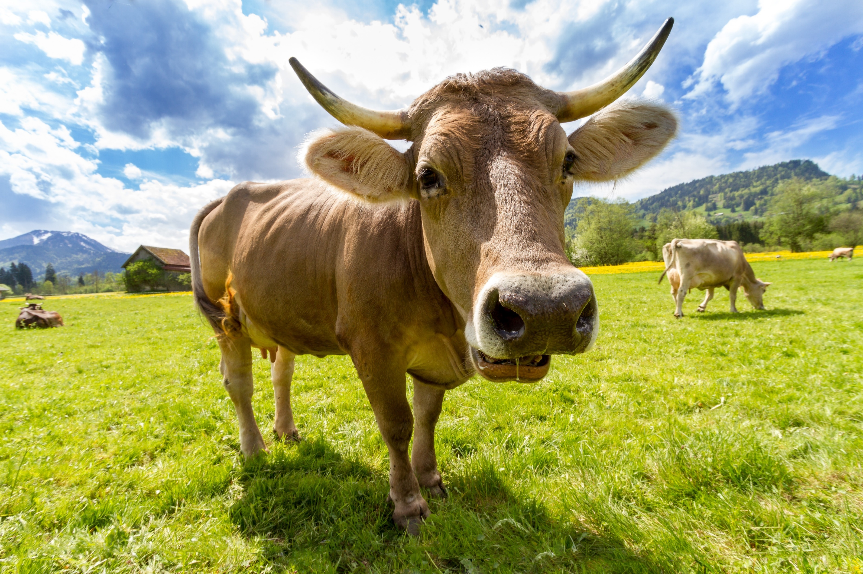
Connected cow
EVERY COMPANY IS NOW A DATA COMPANY
Notes:
the connected cow
This is a connected cow, it’s a fantastic story of keeping things simple and finding ground breaking outcomes using IoT and data analytics
https://youtu.be/oY0mxwySaSo?t=4m33s
https://www.pexels.com/photo-license/
https://www.pexels.com/photo/nature-animal-agriculture-cow-36347/

Slide 3

Connected Drinks
https://aka.ms/marsdrinks

Slide 4

Connected Engines
https://aka.ms/cicustomers

Slide 5
Cortana Intelligence: Data to Intelligent Action
Information Management
Big Data Stores
Machine Learning and Analytics
Intelligence
Data Sources
People
Data Factory
Data Lake Store
Machine Learning
Cognitive Services
Data Catalog
SQL Data
Warehouse
Data Lake Analytics
Bot Framework
Web
Apps
HDInsight
(Hadoop and Spark)
Event Hubs
Cortana
Mobile
Apps
Stream Analytics
Bots
Dashboards & Visualizations
Sensors and devices
Power BI
Automated Systems
Data
Intelligence
Action

Slide 6
Cortana Intelligence: Data to Intelligent Action
Information Management
Data Sources
Data Factory
Data Catalog
Apps
Event Hubs
Sensors and devices
Data

Slide 7
Information Management: Azure Data Factory
Information Management
SQL
Data Factory
INGEST
PREPARE
TRANSFORM & ANALYZE
PUBLISH
Data Catalog
SQL
SQL
DATA CONSUMPTION
DATA SOURCES
<>
Event Hubs
SQL
{ }
Create, schedule, orchestrate, and manage data pipelines
Visualize data lineage
Connect to on-premises and cloud data sources
Monitor data pipeline health
Automate cloud resource management
Move relational data for Hadoop processing
Transform with Hive, Pig, or custom code

Slide 8
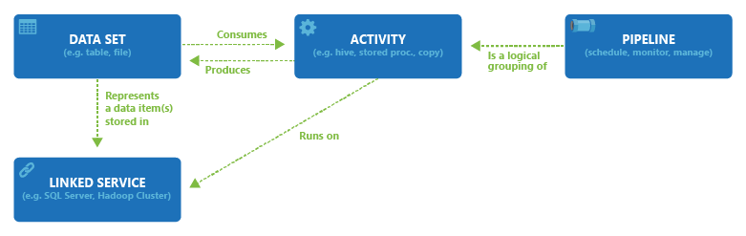
Information Management: Azure Data Factory
Information Management
Data Factory
Data Catalog
Event Hubs
Create, schedule, orchestrate, and manage data pipelines
Visualize data lineage
Connect to on-premises and cloud data sources
Monitor data pipeline health
Automate cloud resource management
Move relational data for Hadoop processing
Transform with Hive, Pig, or custom code

Slide 9



Information Management: Event Hubs
Information Management
Data sources
Data Factory
SQL Database
Machine Learning
Data Catalog
Apps
Azure
API
Management
Event Hubs
Storage
HDInsight
Sensors and devices
Event Hubs
Backend Services
Stream Analytics
Power BI
Data
Log millions of events per second in near real time
Connect devices using flexible authorization and throttling
Use time-based event buffering
Get a managed service with elastic scale
Get a managed service with elastic scale
Reach a broad set of platforms using native client libraries
Pluggable adapters for other cloud services

Slide 10
Demo – Copy Wizard https://docs.microsoft.com/en-us/azure/data-factory/data-factory-copy-data-wizard-tutorial
@AmyKateNicho
Notes:
Work through and build out an experiment in Azure ML from scratch
Bring in data, data pre-processing modules
Split
Train score evaluate
Compare models

Slide 11
Demo – ML Pipeline https://docs.microsoft.com/en-us/azure/data-factory/data-factory-azure-ml-batch-execution-activity
@AmyKateNicho
Notes:
Work through and build out an experiment in Azure ML from scratch
Bring in data, data pre-processing modules
Split
Train score evaluate
Compare models

Slide 12
Cortana Intelligence: Traditional BI
Information Management
Big Data Stores
Machine Learning and Analytics
Intelligence
Data Sources
People
Data Factory
Data Lake Store
Machine Learning
Cognitive Services
Data Catalog
SQL Data
Warehouse
Data Lake Analytics
Bot Framework
Web
Apps
HDInsight
(Hadoop and Spark)
Event Hubs
Cortana
Mobile
Apps
Stream Analytics
Bots
Dashboards & Visualizations
Sensors and devices
Power BI
Automated Systems
Data
Intelligence
Action

Slide 13
Cortana Intelligence: Predictive Analytics
Information Management
Big Data Stores
Machine Learning and Analytics
Intelligence
Data Sources
People
Data Factory
Data Lake Store
Machine Learning
Cognitive Services
Data Catalog
SQL Data
Warehouse
Data Lake Analytics
Bot Framework
Web
Apps
HDInsight
(Hadoop and Spark)
Event Hubs
Cortana
Mobile
Apps
Stream Analytics
Bots
Dashboards & Visualizations
Sensors and devices
Power BI
Automated Systems
Data
Intelligence
Action

Slide 14
Cortana Intelligence: High Scale Data
Information Management
Big Data Stores
Machine Learning and Analytics
Intelligence
Data Sources
People
Data Factory
Data Lake Store
Machine Learning
Cognitive Services
Data Catalog
SQL Data
Warehouse
Data Lake Analytics
Bot Framework
Web
Apps
HDInsight
(Hadoop and Spark)
Event Hubs
Cortana
Mobile
Apps
Stream Analytics
Bots
Dashboards & Visualizations
Sensors and devices
Power BI
Automated Systems
Data
Intelligence
Action

Slide 15



Resources …
Azure Data Factory Documentation and Samples:
https://aka.ms/adf-getstarted
Customer Stories for Cortana Intelligence:
https://aka.ms/cicustomers
Azure Data Factory ideas and feedback:
https://aka.ms/adffeedback
amynic@microsoft.com
@AmyKateNicho

